Slide 1




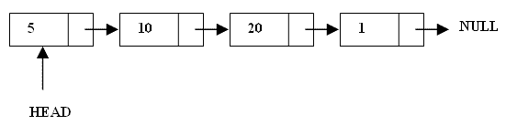
What are Linked Lists
A linked list is a linear data structure.
Nodes make up linked lists.
Nodes are structures made up of data and a pointer to another node.
Usually the pointer is called next.

Slide 2

Arrays Vs Linked Lists
Arrays | Linked list
Fixed size: Resizing is expensive | Dynamic size
Insertions and Deletions are inefficient: Elements are usually shifted | Insertions and Deletions are efficient: No shifting
Random access i.e., efficient indexing | No random access → Not suitable for operations requiring accessing elements by index such as sorting
No memory waste if the array is full or almost full; otherwise may result in much memory waste. | Since memory is allocated dynamically(acc. to our need) there is no waste of memory.
Sequential access is faster [Reason: Elements in contiguous memory locations] | Sequential access is slow [Reason: Elements not in contiguous memory locations]

Slide 3

Types of lists
 There are two basic types of linked list
Singly Linked list
Doubly linked list

Slide 4

Singly Linked List
Each node has only one link part
Each link part contains the address of the next node in the list
Link part of the last node contains NULL value which signifies the end of the node

Slide 5






Schematic representation
 Here is a singly-linked list (SLL):
myList
a
b
c
d
Each node contains a value(data) and a pointer to the next node in the list
myList is the header pointer which points at
the first node in the list

Slide 6

Basic Operations on a list
Creating a List
Inserting an element in a list
Deleting an element from a list
Searching a list
Reversing a list

Slide 7

Creating a node
struct node{
int data;
struct node *next;
}*start;
start=NULL ;
// A simple node of a linked list
//start points at the first node
initialised to NULL at beginning

Slide 8


struct node* create( int num) //say num=1 is passed from main
{
struct node*ptr;
ptr= (struct node*)malloc(sizeof(struct node));//memory allocated dynam if(ptr==NULL)// no memory available
exit(1);
else
{
ptr->data=num;
ptr->next=NULL;
return ptr;
}
}

Slide 9

To be called from main() as:-
int main()
{
struct node* ptr;
int data;
printf(“enter the element\n”);
scanf(“%d”,data);
ptr=create(data);
return 0;
}

Slide 10

Inserting the node in a SLL
There are 3 cases here:-
Insertion at the beginning
Insertion at the end
Insertion after a particular node

Slide 11

Insertion at the beginning
There are two steps to be followed:-
Make the next pointer of the node point towards the first node of the list
Make the start pointer point towards this new node
If the list is empty simply make the start pointer point towards the new node;

Slide 12

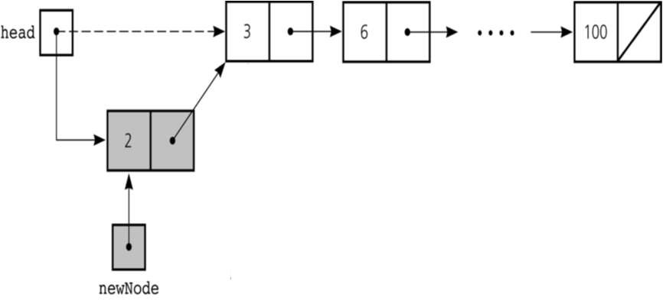

Slide 13

}
struct node* insert_beg(struct node* start, int ele)
{ struct node *p ;
p=(struct node*)malloc(sizeof(struct node));//memory alloc
p->data=ele;
if(start==NULL)
{
start=p;
start->next=NULL;
//if the list is empty
printf(”\nNode inserted successfully at the beginning\n”);
}
else {
p->next=start; //making new node point at
the first node of the list
start=p;
}
return start;
}

Slide 14
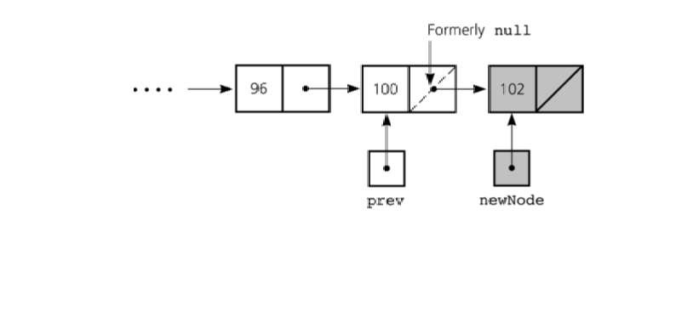
Inserting at the end
Here we simply need to make the next pointer of the last node point to the new node

Slide 15

struct node* insert_end(struct node* start,int ele)
{
struct node *p,*q=start;
p=(struct node*)malloc(sizeof(struct node));
p->data=ele;
p->next=NULL;
if(start==NULL)
{
start=p;
printf(“\nNode inserted successfully at the end…!!!\n”);
}
else{
while(q->next!=NULL) q=q->next;
q->next=p;
}
return start;
}

Slide 16

Inserting after an element
Here we again need to do 2 steps :-
Make the next pointer of the node to be inserted point to the next node of the node after which you want to insert the node
Make the next pointer of the node after which the node is to be inserted, point to the node to be inserted

Slide 17

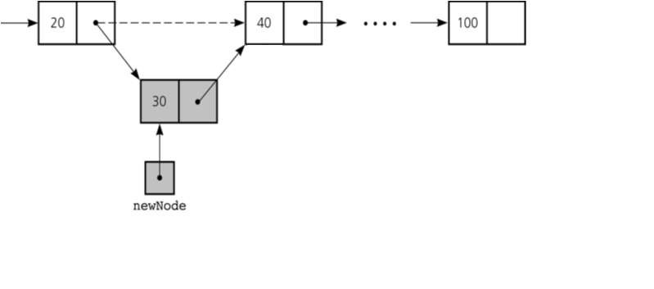

Slide 18
struct node* insert_after(int c, struct node* start, int ele)
{
struct node *p,*q; int i=1; q=start;
while(i<c&&q!=NULL)
{
q=q->next;
++i;
}
if(q==NULL)
printf(“\nLess than %d nodes in the list\n”, c);
else
{
p=(struct node*)malloc(sizeof(struct node));
p->data=ele;
p->next=q->next;
q->next=p;
printf(”\nNode inserted successfully\n”;);
}
return start;
}

Slide 19

Deleting a node in SLL
Here also we have three cases:-
Deleting the first node
Deleting the last node
Deleting the intermediate node

Slide 20


Deleting the first node
Here we apply 2 steps:-
Making the start pointer point towards the 2nd node
Deleting the first node using free
start
one
two
three

Slide 21

struct node* del_first(struct node* start)
{
if(start==NULL)
printf(”\nError……List is empty\n”);
else
{
node* temp=start;
start=start->next;
free( temp);
printf(”\nFirst node deleted successfully\n”);
}
return start;
}

Slide 22



Deleting the last node
Here we apply 2 steps:-
Making the second last node’s next pointer point to NULL
Deleting the last node via free
start
node1
node2
node3

Slide 23

struct node* del_last(struct node* start)
{
if(start==NULL)
printf(”\nError….List is empty\n”);
else{
struct node* q=start;
if(start->next==NULL)//only one node
{ free(start);start=NULL; }
else
{
while(q->next->next!=NULL) q=q->next;
node* temp=q->next; q->next=NULL;
free( temp);
}
printf(”\nDeleted successfully\n…”);
}
return start;
}

Slide 24

Deleting a particular node
Here we make the next pointer of the node previous to the node being deleted ,point to the successor node of the node to be deleted and then delete the node using delete keyword
node1 node2
node3
To be deleted

Slide 25

struct node* del(int c, struct node* start)
{
if(start==NULL)
printf(“list is empty\n”);
else
{
if(c==1&& start->next==NULL)//only one node
{ free(start);
start= NULL;
printf(“\nDeleted Successfully\n”);
}
else

Slide 26
{ int i=1; struct node* q=start;
while(i<c-1&&q!=NULL)
{ q=q->next;
i++;
}
if(q==NULL)
printf(“\nNode not found\n”);
if(i==c-1||c==1)
{ struct node* p=q->next;
q->next=p->next;
free(p);
printf(“\nDeleted Successfully\n”);
}
}
}
return start;
}

Slide 27
struct node* del(int c, struct node* start)
{
if(start==NULL)
printf("list is empty\n");
else
{ struct node *prev=NULL,*q=start;
if(c==1)//only one node
{
start=start->next;
free(q);
printf("\nDeleted Successfully\n");
}
else

Slide 28
{ int i=1;
struct node *prev=NULL,*q=start;
while(i<c&&q!=NULL)
{ prev=q;
q=q->next;
i++;}
if(q==NULL)
printf("\nNode not found\n");
else
{ prev->next=q->next;
free(q);
printf("\nDeleted Successfully\n");
}
}
}
return start;
}

Slide 29
void display(struct node* start)
{
struct node*temp=start;
if(temp==NULL)
printf(“list empty\n”);
else
{
printf(“list elements\n”);
while(temp!=NULL)
{
printf(“%d\t ”,temp->data);
temp=temp->next;
}
}
}

Slide 30

Searching a SLL
Searching involves finding the required element in the list
We can use various techniques of searching like linear search or binary search where binary search is more efficient in case of Arrays
But in case of linked list since random access is not available it would become complex to do binary search in it
We can perform simple linear search traversal

Slide 31

In linear search each node is traversed till the data in
the node matches with the required value
void search(struct node* start,int x)
{
struct node*temp=start; while(temp!=NULL)
{
if(temp->data==x)
{
printf(“FOUND %d\n ”,temp->data); break;
}
temp=temp->next;
}
if(temp==NULL)
printf(“element not found\n”);
}

Slide 34

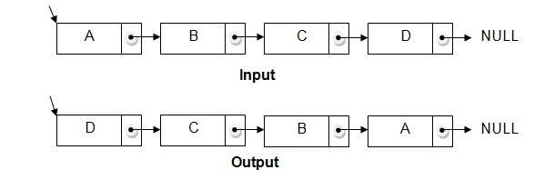
Reversing a linked list
We can reverse a linked list by reversing the direction of the links between 2 nodes

Slide 35

We make use of 3 structure pointers say p,q,r
At any instant q will point to the node next to p and r will point to the node next to q
Head
P
qp
rq
NULL
NULL
For next iteration p=q and q=r
At the end we will change head to the last node

Slide 36

Code
void reverse()
{
node*p,*q,*r; if(start==NULL)
{
cout<<"\nList is empty\n";
return;
}
p=start; q=p->link;
p->link=NULL;
while(q!=NULL)
{
r=q->link; q->link=p; p=q;
q=r;
}
start=p;
cout<<"\nReversed successfully";
}

Slide 37

COMPLEXITY OF VARIOUS OPERATIONS IN ARRAYS AND SLL
Operation | ID-Array Complexity | Singly-linked list Complexity
Insert at beginning | O(n) | O(1)
Insert at end | O(1) | O(1) if the list has tail reference O(n) if the list has no tail reference
Insert at middle | O(n) | O(n)
Delete at beginning | O(n) | O(1)
Delete at end | O(1) | O(n)
Delete at middle | O(n): O(1) access followed by O(n) shift | O(n): O(n) search, followed by O(1) delete
Search | O(n) linear search O(log n) Binary search | O(n)
Indexing: What is the element at a given position k? | O(1) | O(n)

Slide 38

Doubly Linked List
1. Doubly linked list is a linked data structure that consists of a set of sequentially linked records called nodes.
2 .
Each node contains three fields ::
-: one is data part which contain data only.
-:two other field is links part that are point or references to the previous or to the next node in the sequence of nodes.
3.
The beginning and ending nodes' previous and next links, respectively, point to some kind of terminator, typically a sentinel node or null to facilitate traversal of the list.

Slide 39

NODE
previous | data | next
A
B
C
NULL | 11 | 786
200
656
400
786 | 777 | NULL
200
786
400
A doubly linked list contain three fields: an integer value, the link to the next node, and the link to the previous node.

Slide 40
DLL’s compared to SLL’s
Advantages:
Can be traversed in either direction (may be essential for some programs)
Some operations, such as deletion and inserting before a node, become easier
Disadvantages:
Requires more space
List manipulations are slower (because more links must be changed)
Greater chance of having bugs (because more links must be manipulated)

Slide 41

Structure of DLL
struct node
{
int data; node*next; node*previous;
};
//holds the address of previous node
previous.
.Data
.next
inf

Slide 42



Inserting at beginning

Slide 43

void insert_beg(node *p)
{
if(start==NULL)
{
start=p;
cout<<"\nNode inserted successfully at the beginning\m";
}
else
{
node* temp=start;
start=p;
temp->previous=p; new node
p->next=temp;
1st node
//making 1st node’s previous point to the
//making next of the new node point to the
cout<<"\nNode inserted successfully at the beginning\n";
}

Slide 44

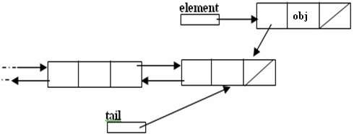
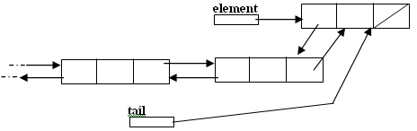
Inserting at the end

Slide 45

void insert_end(node* p)
{
if(start==NULL)
{
start=p;
cout<<"\nNode inserted successfully at the end";
}
else
{
node* temp=start; while(temp->next!=NULL)
{
temp=temp->next;
}
temp->next=p;
p->previous=temp;
cout<<"\nNode inserted successfully at the end\n";
}
}

Slide 46

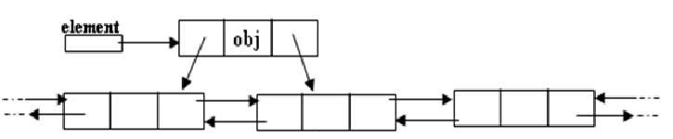
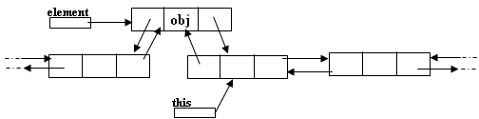
Inserting after a node
Making next and previous pointer of the node to be inserted point accordingly
Adjusting the next and previous pointers of the nodes b/w which the new node accordingly

Slide 47

void insert_after(int c,node* p)
{
temp=start;
for(int i=1;i<c-1;i++)
{
temp=temp->next;
}
p->next=temp->next; temp->next->previous=p; temp->next=p;
p->previous=temp; cout<<"\nInserted successfully";
}

Slide 48



Deleting a node
Node deletion from a DLL involves changing two links
In this example,we will delete node b
myDLL
a b
c
We don’t have to do anything about the links in node b
Garbage collection will take care of deleted nodes
Deletion of the first node or the last node is a special case

Slide 49

void del_at(int c)
{
node*s=start;
{
for(int i=1;i<c-1;i++)
{
s=s->next;
}
node* p=s->next; s->next=p->next;
p->next->previous=s; delete p;
cout<<"\nNode number "<<c<<" deleted successfully";
}
}
}

Slide 50

APPLICATIONS OF LINKED LIST
Applications that have an MRU list (a linked list of file names)
The cache in your browser that allows you to hit the BACK button (a linked list of URLs)
Undo functionality in Photoshop or Word (a linked list of state)
A stack, hash table, and binary tree can be implemented using a doubly linked list.

Slide 51

Polynomials
Array Implementation:
p1(x) = 8x³ + 3x² + 2x + 6
p2(x) = 23x⁴ + 18x - 3
p1(x)
p2(x)
6 | 2 | 3 | 8
-3 | 18 | 0 | 0 | 23
0
2
0
2
4
Index represents exponents

Slide 52

This is why arrays aren’t good to represent polynomials:
p3(x) = 16x²¹ - 3x⁵ + 2x + 6
6 | 2 | 0 | 0 | -3 | 0 | ………… | 0 | 16
WASTE OF SPACE!

Slide 53

Advantages of using an Array:
only good for non-sparse polynomials.
ease of storage and retrieval.
Disadvantages of using an Array:
have to allocate array size ahead of time.
huge array size required for sparse polynomials. Waste of space and runtime.

Slide 54


Polynomial Representation
Linked list Implementation:
p1(x) = 23x⁹ + 18x⁷ + 41x⁶ + 163x⁴ + 3
p2(x) = 4x⁶ + 10x⁴ + 12x + 8
P1
23 9
18 7
41 6
18 7
3
0
TAIL (contains pointer)
P2
4 6
10 4
12 1
8 0
NODE (contains coefficient & exponent)

Slide 55

Advantages of using a Linked list:
save space (don’t have to worry about sparse polynomials) and easy to maintain
don’t need to allocate list size and can declare nodes (terms) only as needed
Disadvantages of using a Linked list :
can’t go backwards through the list
can’t jump to the beginning of the list from the end.

Slide 56



Polynomials
A(x)
^{e}m 1
a_{m 1} x a_{m}
^{e}m 2 ^{e}0
₂ x ... a₀ x
Representation
struct polynode {
int coef;
int exp;
struct polynode * next;
};
typedef struct polynode *polyptr;
coef | exp | next

Slide 57

Adding polynomials using a Linked list representation: (storing the result in p3)
To do this, we have to break the process down to cases:
Case 1: exponent of p1 > exponent of p2
Copy node of p1 to end of p3. [go to next node]
Case 2: exponent of p1 < exponent of p2
Copy node of p2 to end of p3. [go to next node]

Slide 58

Case 3: exponent of p1 = exponent of p2
Create a new node in p3 with the same exponent and with the sum of the coefficients of p1 and p2.

Slide 59




Example
_{3x}14
a
2x⁸ 1
a
3
14
2
8
1 | 0 | null
b
b
_{8x}14
_{3x}10
10x⁶
8
14
-3
10
10 | 6 | null

Slide 60

Adding Polynomials
3 14
2 8
-3 10
1 0
10 6
a
8 14
b
11 | 14
a->expon == b->expon
d
3 14
2 8
-3 10
1 0
a
8 14
11 14
10 6
b
-3 | 10
a->expon < b->expon

Slide 61

3
14
2
8
1
0
a
8
14
-3
10
10
6
b
11
14
-3
10
2
8
d
a->expon > b->expon

Slide 62


THANK YOU

